Slide 1
Employee Data Analysis using Excel
STUDENT NAME : YUGAPRIYA G REGISTER NO : 2213391036064/
NM ID : 3D140B76DA47097AB9741D3F2571684D DEPARTMENT : COMMERCE COLLEGE : QUEEN MARY’S COLLEGE

Slide 2

PROJECT TITLE
Employee Performance Analysis using Excel

Slide 3


AGENDA
Problem Statement
Project Overview
End Users
Our Solution and Proposition
Dataset Description
Modelling Approach
Results and Discussion
Conclusion
3/21/2024 Annual Review

Slide 4

PROBLEM STATEMENT
Prformance analysis are made to a employees. Increment to check the performance track of the employees and it is useful for the employees personal as well as organizational growth.
So, the employees performance analysis helps to require all the problems and have a successful organisation.

Slide 5

PROJECT OVERVIEW
Analysing the performance of the employees by considering the various factors like;
Gender,
Performance score and
Ratings.
Their involvement in work and various scores that analysis the performance of employees in the organization.

Slide 6


WHO ARE THE END USERS?
Employees Employer Manager,
Gets benefits from the performance appraisal

Slide 7

OUR SOLUTION AND ITS VALUE PROPOSITION
Conditional Formatting – missing values
Filtering : remove missing data
Formulas : performance evaluation
Pivot : summary
Graph : data visualization

Slide 8

Dataset Description
EMPLOYEES DATABASE KIGGLE
There are 26 features but we consider 9 features
Employees ID ￼ Numerical data
Name Text
Performance Level
Gender Male Or Female
Employees rating Numerical data

Slide 9

THE "WOW" IN OUR SOLUTION
Sample Queries: 1. Get all characters in a guild: `SELECT * FROM Characters JOIN Members ON CharacterID = CharacterID WHERE GuildID = [GuildID]` 2. Get all raids a character has participated in: `SELECT * FROM Raids JOIN RaidMembers ON RaidID = RaidID WHERE CharacterID = [CharacterID]` This database design captures key WoW data and relationships, enabling you to store and query character, guild, and raid information.
3/21/2024 Annual Review
9

Slide 10

MODELLING
Data collection
Feature collection
Data cleaning
Performance level
Summary
Visualisation
10

Slide 11
Data collection
In data collection we download the data from
the edunet dashboard to work in the excel.
Feature collection
So many features are used in the data like filtering,
formatting, formulating. Pivot table, graph and used in data.
Data Cleaning
Identified the missing values and remove those missing
value from the data.

Slide 12
Performance level
We evaluate the performance of the employees according to the data.
Summary
Pivot table we are categorized the columns what we need and organization in the data.
Visualisation
In graph method we have shown the performance data analysis and it is easy to identify the percentage.

Slide 13
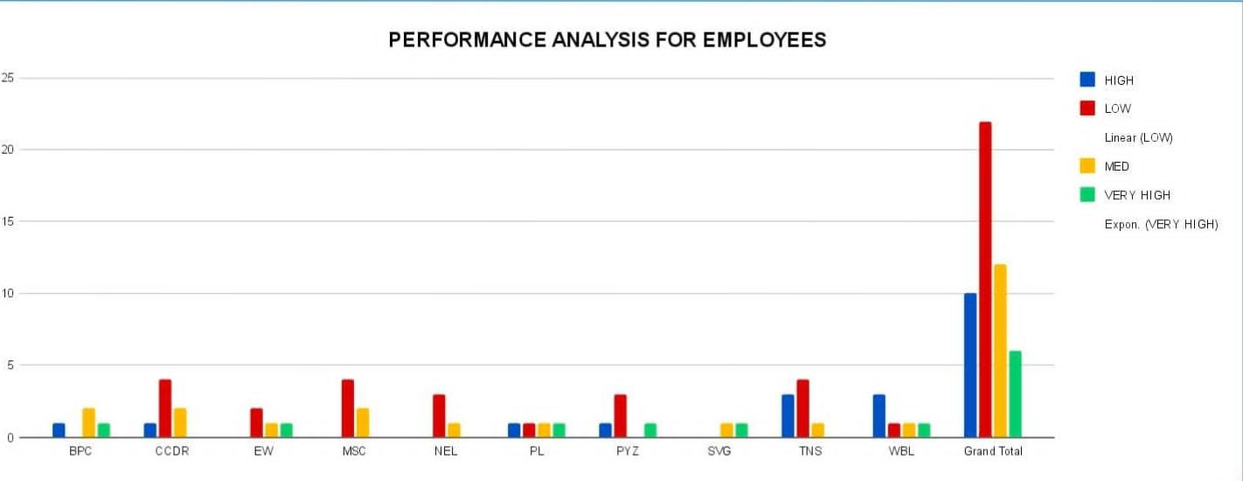
RESULTS
13

Slide 14
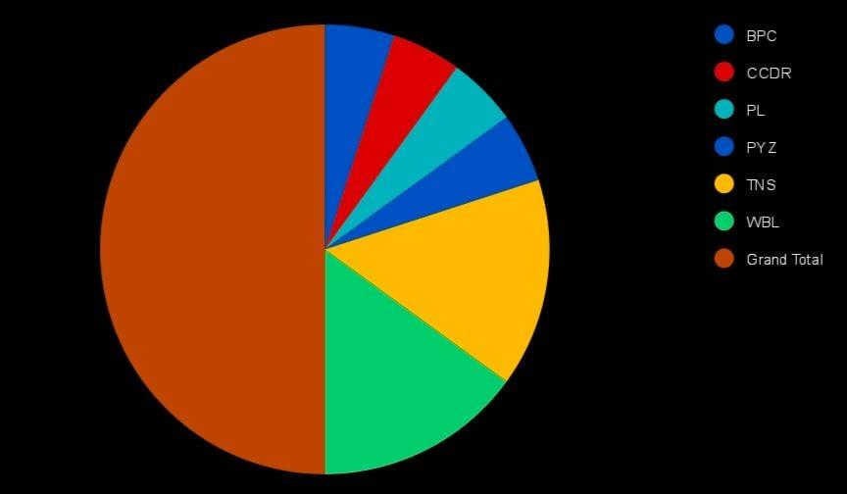
RESULT:

Slide 15
conclusion
While comparing the performance of employees, the number of employees are higher in number is in the average performance where excellence employees are less in percentage. So to overcome this we should motivate the employees by giving there different tasks based on their skills to improve their performance in their work.

